Slide 1
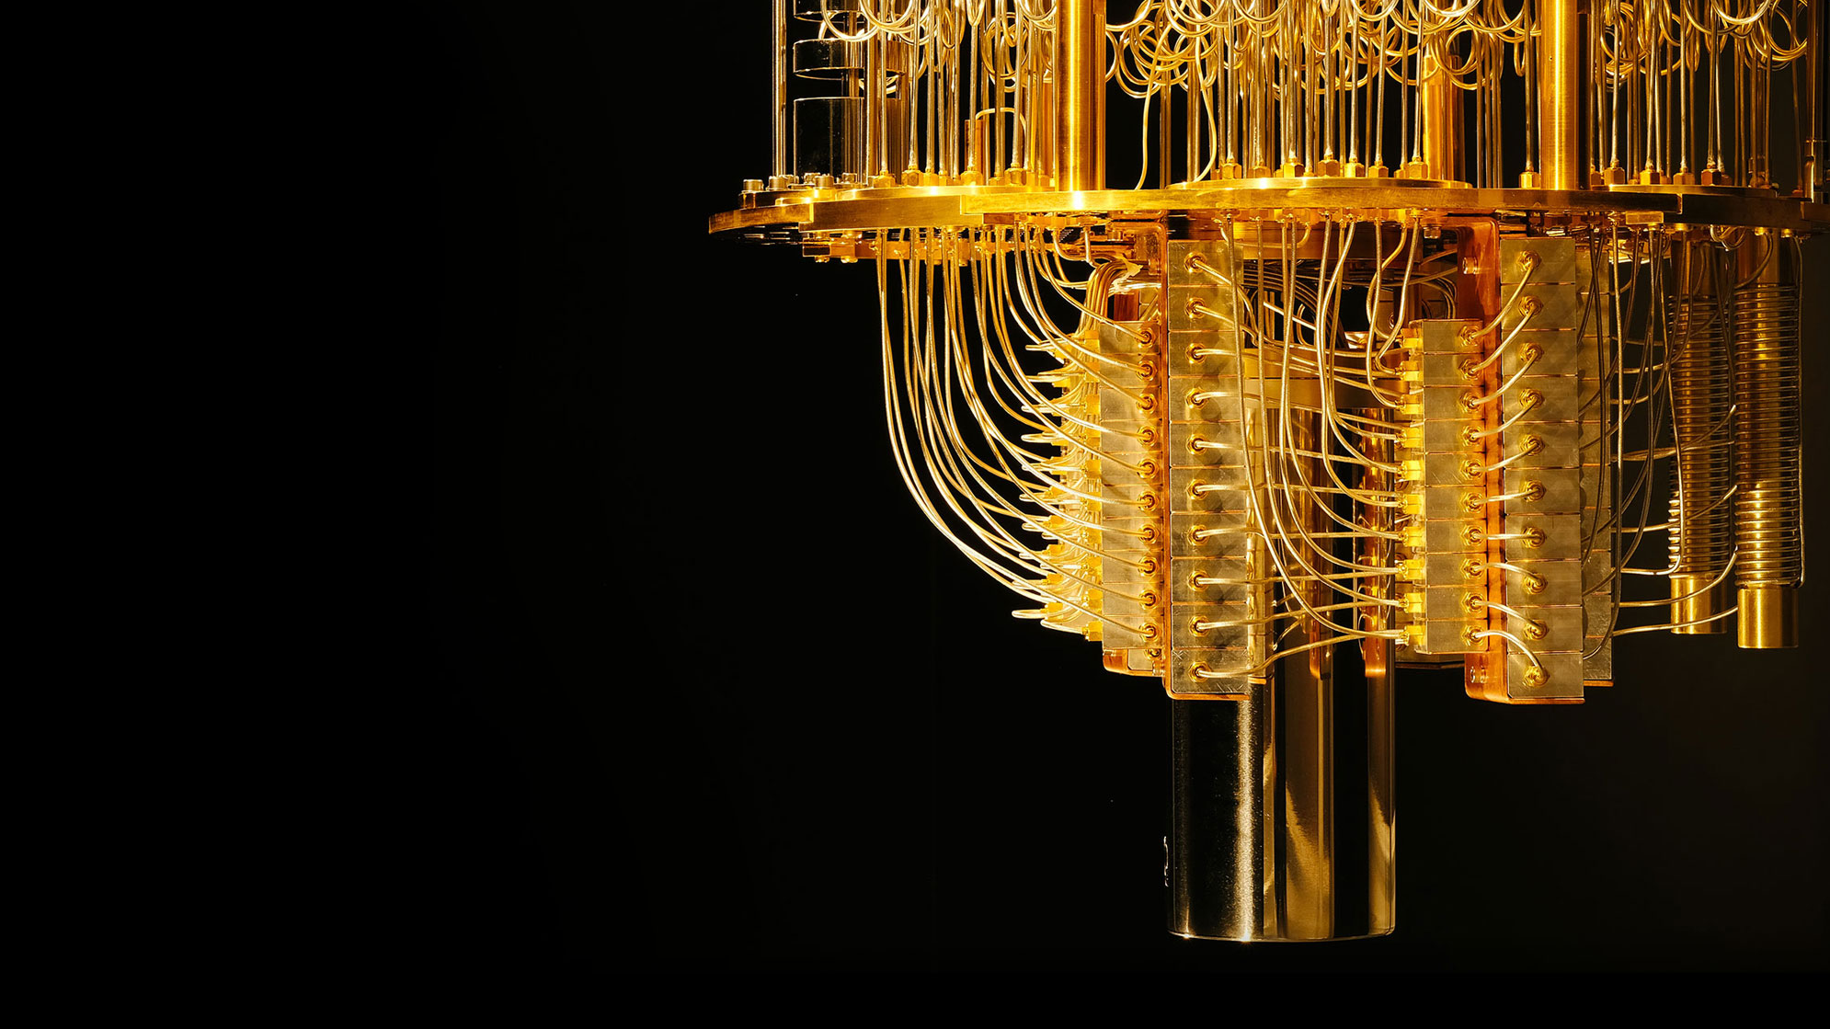
States, Gates and Circuits
Priya Angara, Ulrike Stege

Slide 2
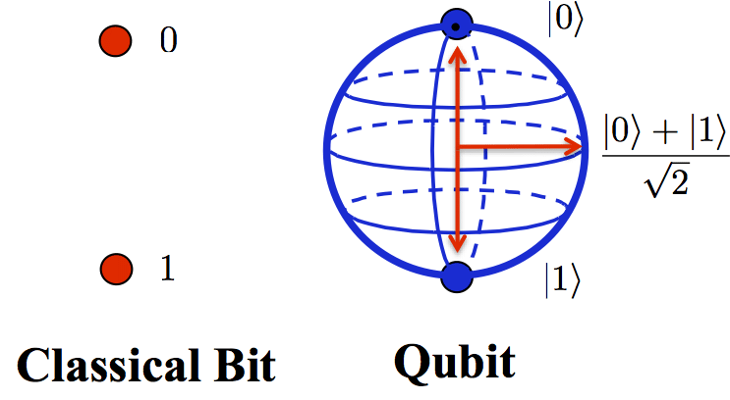
Bits vs Qubits

Slide 3

Qubits: Notation
This is the called the dirac notation or the bra/ket notation
|0> -> this is a Ket
<0| -> this is a Bra
They are special symbols that simplify the math for us.
(Bra/Kets simplify vectors and complex conjugates.)

Slide 4
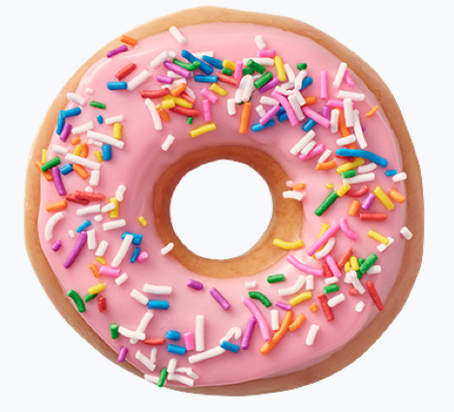
|0>

Slide 5
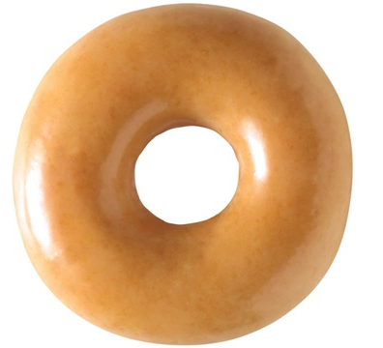
|1>

Slide 6

Superposition!

Slide 7

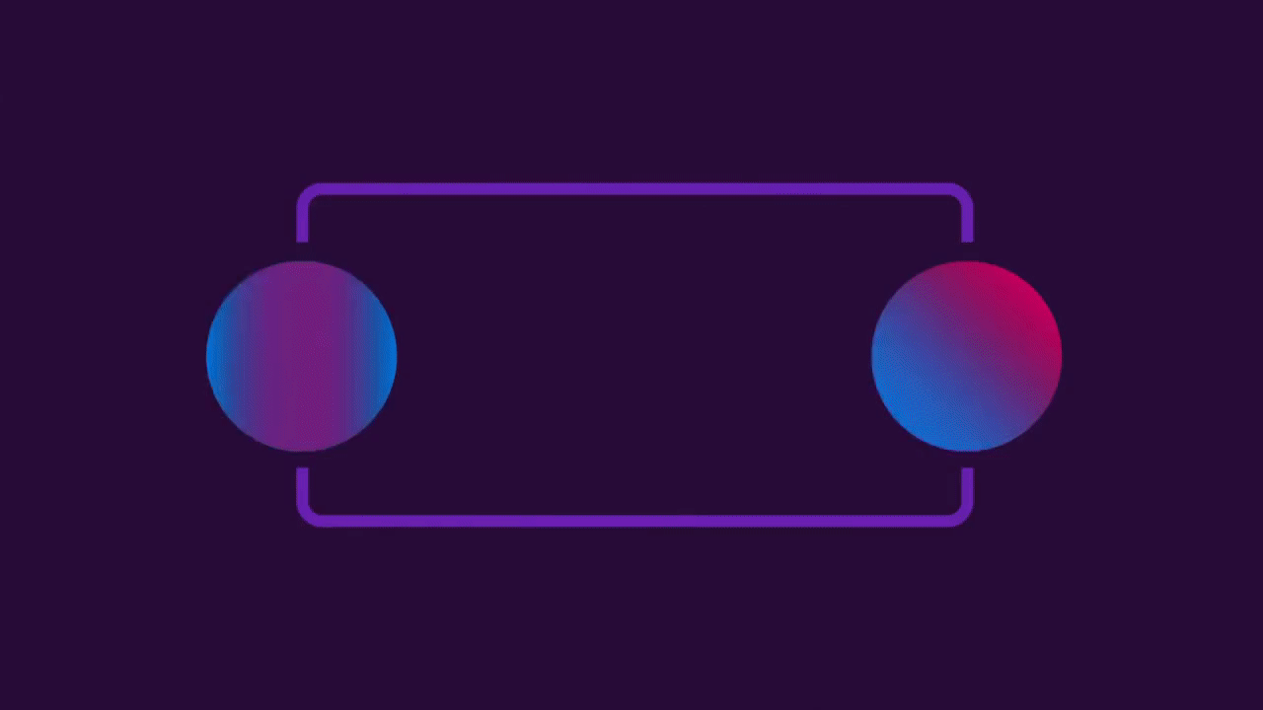
Superposition
Think of a state being the spinning donut.
How plain/pink is our state?
As soon as the state is measured, it will be either plain or pink

Slide 8
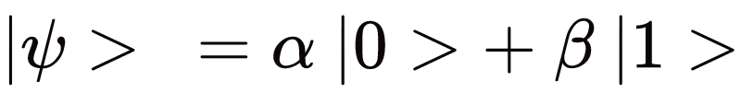
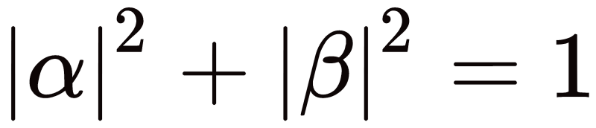
The Quantum State ( )

Slide 9
Quantum State (|Ψ >)

Slide 10
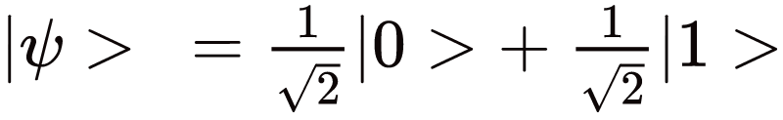
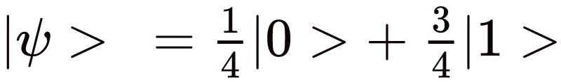
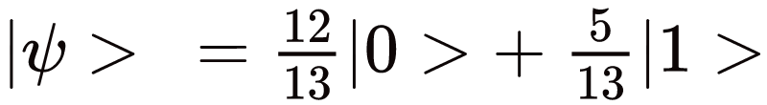
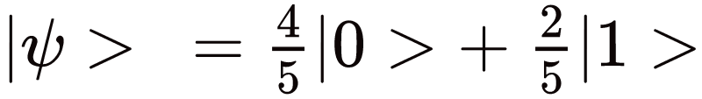
What is a valid quantum state?
Notes:
Square what is a square what is a sq root

Slide 11

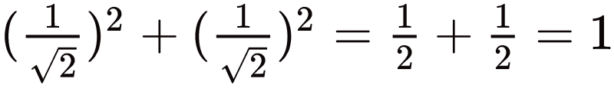
What is a valid quantum state?

Slide 12
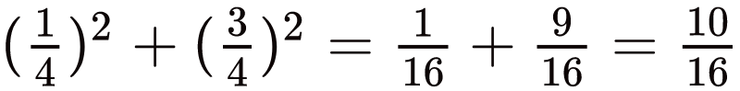
What is a valid quantum state?

Slide 13
What is a valid quantum state?

Slide 14
Activity: Find your Quantum Partner!
|0>
|1>
Pick a ball
Find a person with a ball of a color different from yours, and an amplitude that makes your combined state a quantum state.

Slide 15
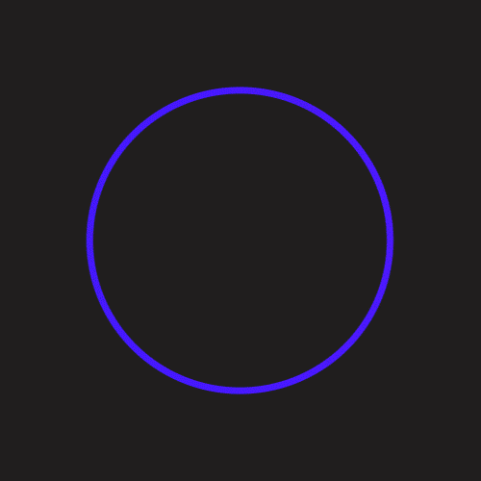
Molding states using gates

Slide 16
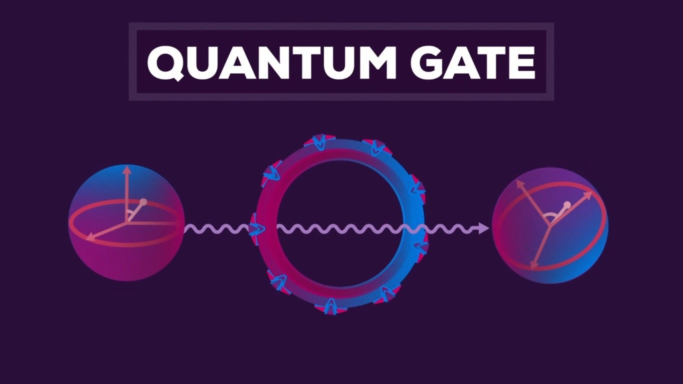
Moulding Quantum States

Slide 17

Identity Gate
|0> → |0>
|1> → |1>
I

Slide 18

NOT Gate
|0> → |1>
|1> → |0>
X

Slide 19
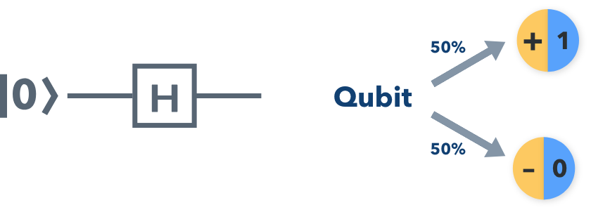
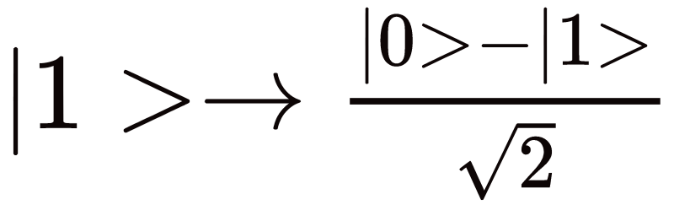
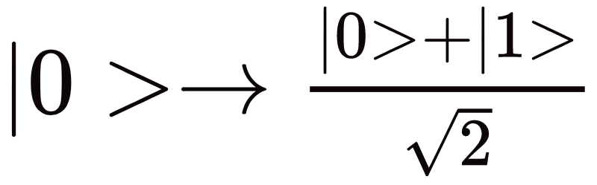
Hadamard Gate
Notes:
https://towardsdatascience.com/quantum-computing-with-colorful-diagrams-8f7861cfb6da

Slide 20
What’s the state after applying the gates?
|1>
X
X
?
|0>
H
X
?
|0>
X
H
H
X
?
H
?
Notes:
Put in jhandout
If you don know sq root – what is the sqquare

Slide 21
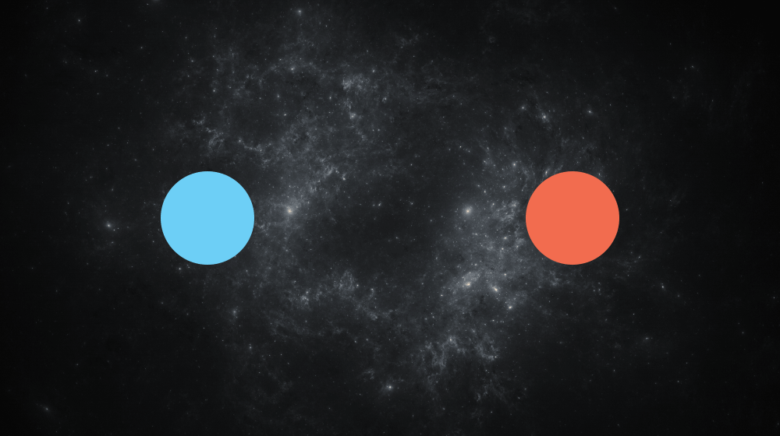
Measurement: Qubits are shy
Whatever state qubits are in, they resolve to 0 or 1 on measurement

Slide 22
Measurement
|1>
X
X
|1>
?
H
X
?
|0>
X
H
H
X
?
|0>
|0>
`
H
|0>
?

Slide 23
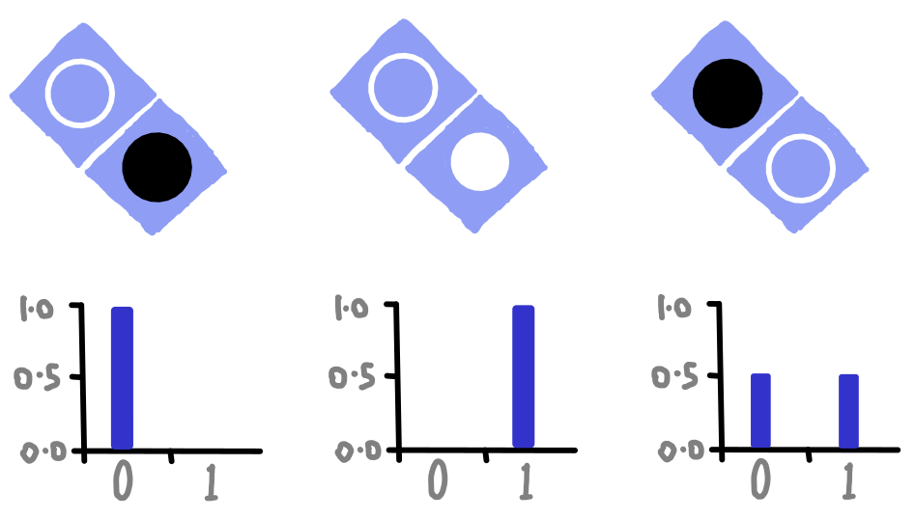
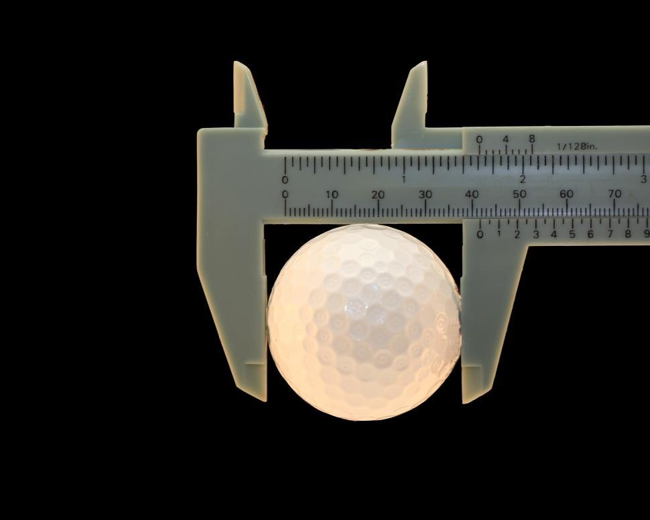
What’s the state after applying the gates?
|1>
|0>
|0>

Slide 24
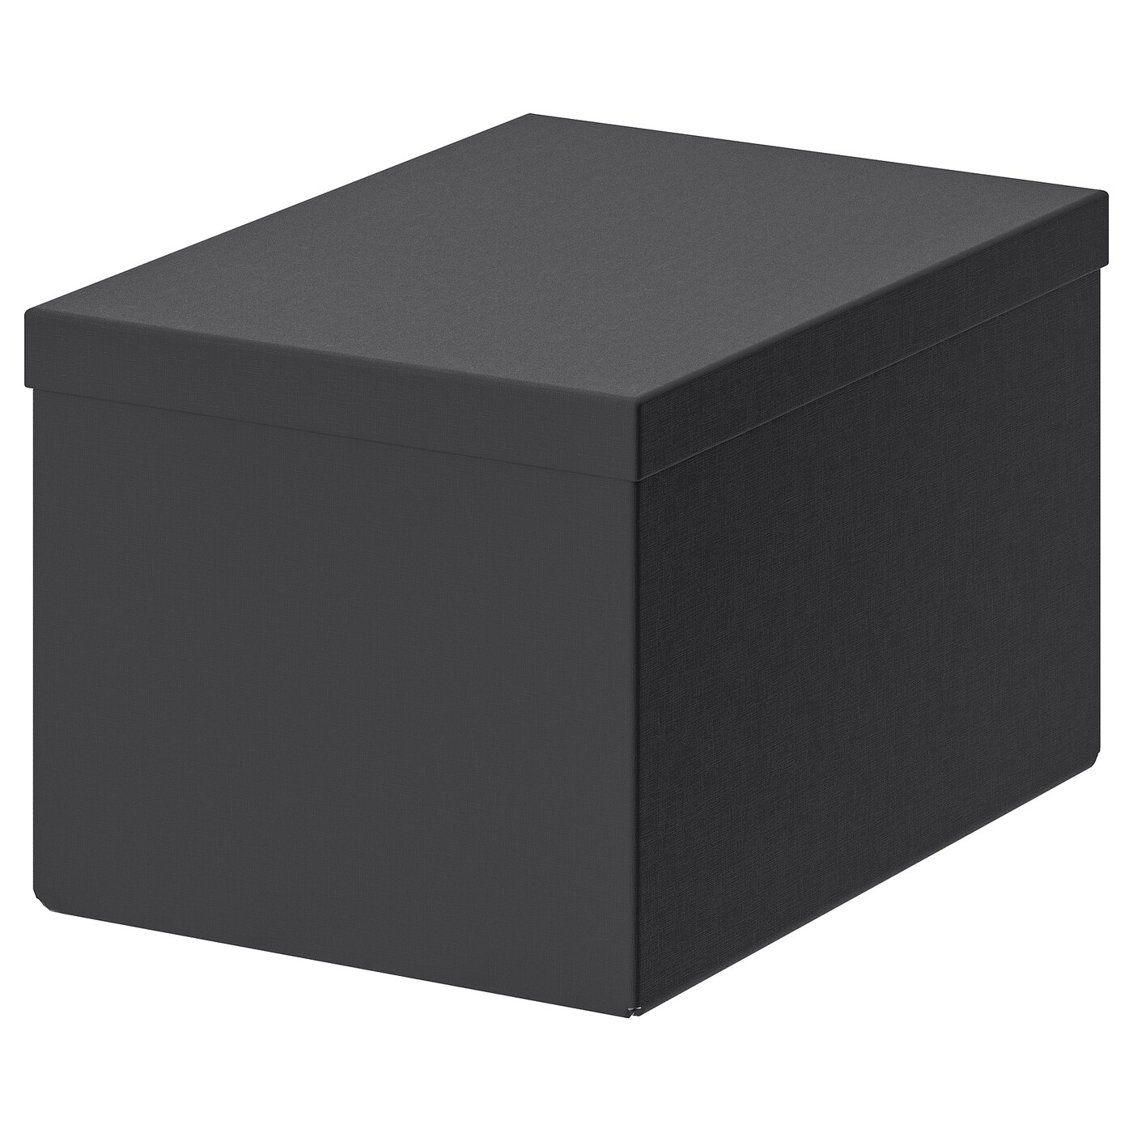
Guessing game
The box has 50 balls colored pink and grey.
How many of these are pink, and how many are grey?
Can you make a guess?
Let’s sample from the box and speculate!

Slide 25
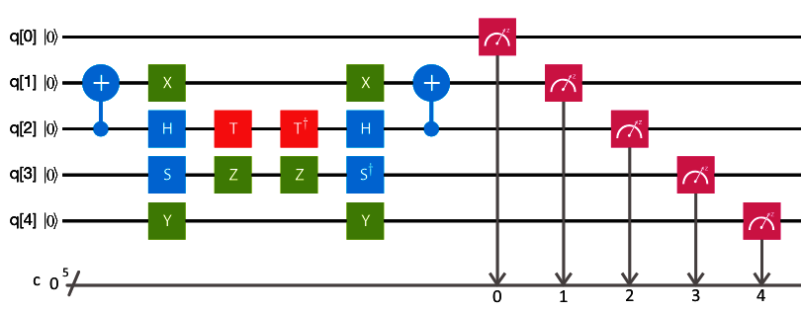
Quantum Circuits
A sequence of gates that performs a specific task.
There can be multiple qubits involved in a quantum system
Basic elements: qubits, classical bits, gates, measurement

Slide 26
Qubits
qr = QuantumRegister(5)

Slide 27
Classical Bits
cr = ClassicalRegister(5)

Slide 28
Why do we need classical registers?
Once a qubit is measured, the value of it is classical (just 0 or 1), therefore we can store them in a classical storage.
(A register is where you store values, or data, just like a physical register)

Slide 29
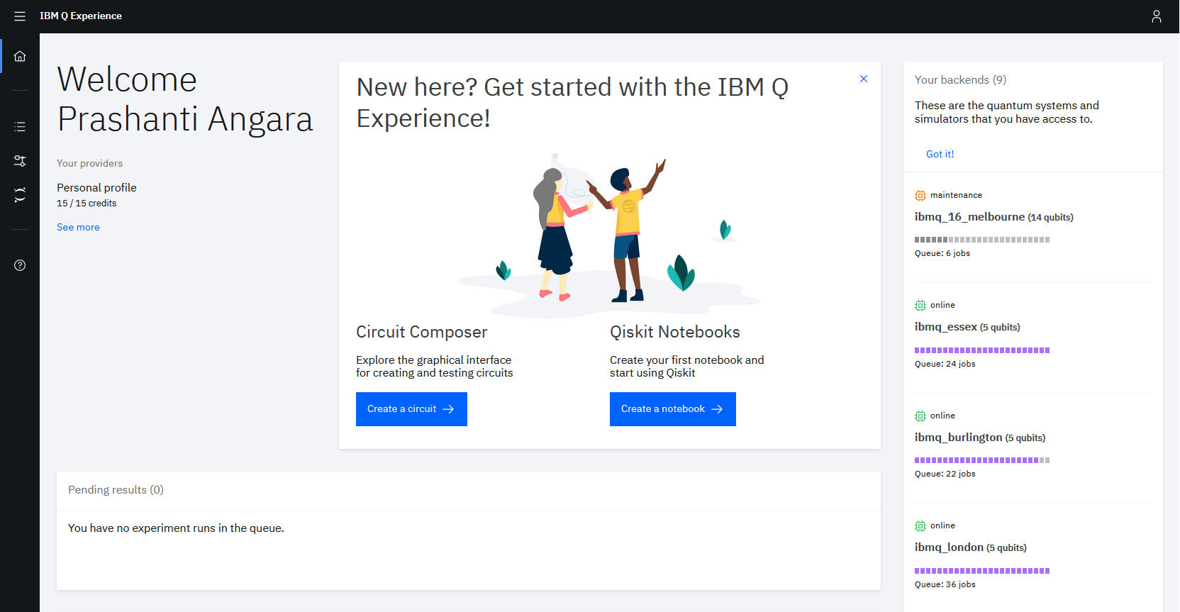
The circuit composer
Open quantum-computing.ibm.com
The circuit composer lets you design and run circuits using a graphical user interface (i.e. you can drag and drop gates to form a circuit)

Slide 30
Circuit
circ = QuantumCircuit(qr,cr)

Slide 31
Gates
circ.x (1)

Slide 32
Measurement
circuit.measure(qr, cr)

Slide 33
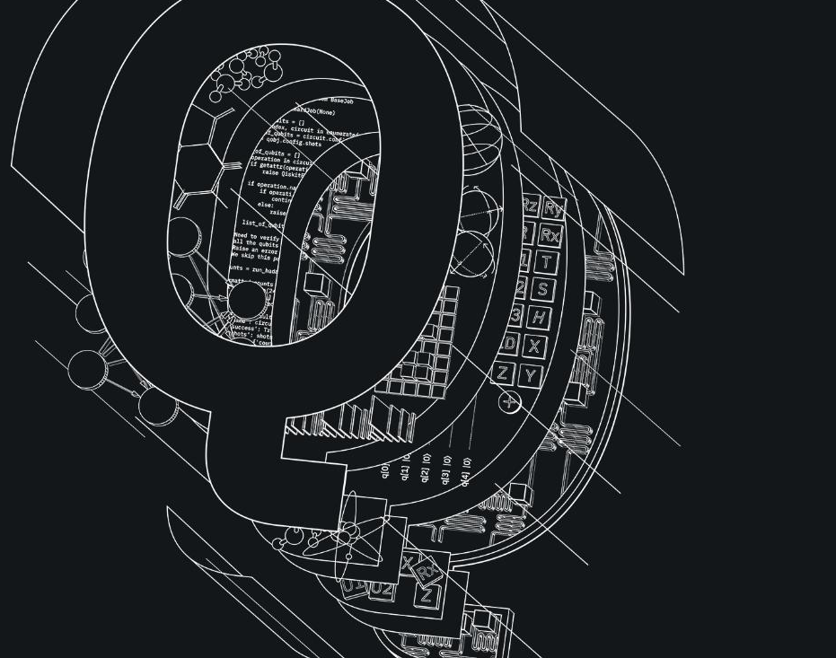
Let’s Qode!
Open the circuit composer on
quantum-computing.ibm.com

Slide 34
Next up: Qiskit Notebooks
These are Jupyter notebooks. One can design and run experiments using code written in Python and Qiskit

